Slide 1
Scouting America
Leave No Trace Instructor Course

Slide 2
Needs Updating
This presentation has only placeholder slides for Sea Scouting as the OE Award requirements are not yet published
Leave No Trace in Scouting America
Advancement and Awards

Slide 3
Objectives
Goals: As a result of this session, each participant should be able to:
Discuss references to Leave No Trace and the Outdoor Code in the Cub Scout advancement program.
Discuss references to Leave No Trace in Scouts BSA requirements.
Discuss references to Leave No Trace in the Venturing Ranger and Outdoor Bronze Award.
Discuss the requirements for the Outdoor Ethics Awareness and Action Awards for Scouts, Sea Scouts, Venturers, and Scouters.

Slide 4






Cub Scout Advancement
Lions
  Mountain Lion
Tigers
  Tigers in the Wild
Wolves
  Paws on the Path
Notes:
Many elective adventures such as Champions for Nature have requirements that explore Outdoor Ethics and conservation.

Slide 5






Cub Scout Advancement
Bears
  Bear Habitat
Webelos
  Webelos Walkabout
Arrow of Light
  Outdoor Adventurer
Notes:
Many elective adventures such as Champions for Nature have requirements that explore Outdoor Ethics and conservation.

Slide 6


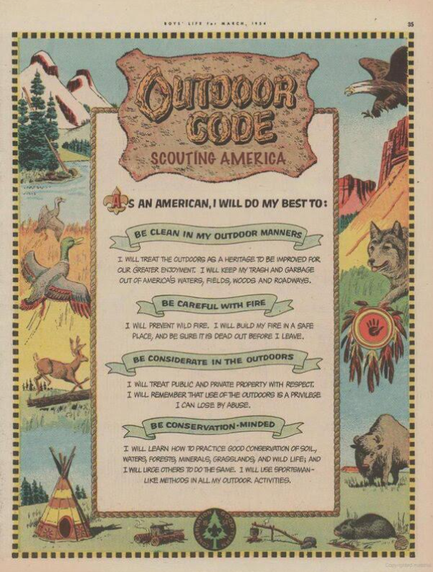

Progression of Outdoor Ethics in Cub Scout Advancement
Listen Recite Discuss Demonstrate Explain

Slide 7



Cub Scout Awards
Outdoor Activity Award
  Different requirements for each rank: Tiger, Wolf, Bear, Webelo
  Requirements based on Adventures which include Leave No Trace
  Participate in outdoor activities: (4,5,6,7)
Nature hike
Picnic or park fun day
Explain the buddy system
Pack overnighter
Outdoor service project
Nature/conservation project
Earn the Summertime Pack Award
Nature observation activity
Outdoor aquatics activity
Outdoor campfire program
Outdoor sporting event
Outdoor interfaith or other worship service
Explore a local city, county, state, or national park
Invent an outside game and play it outside

Slide 8



Progression of Outdoor Ethics in Scouts, BSA Advancement
Repeat & Explain Demonstrate Teach

Slide 9


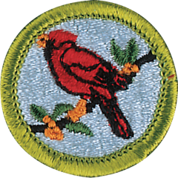










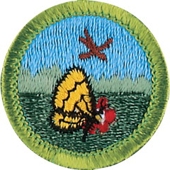

Merit Badges
Merit Badges which specifically mention the Outdoor Code, Leave No Trace, or Tread Lightly!:
Fishing
Fly Fishing
Geocaching
Geology
Hiking
Insect Study
Nature
Signs Signals and Codes
Architecture
Backpacking
Bird Study
Camping
Climbing
Cooking
Exploration

Slide 10

Scouts BSA Outdoor Ethics Awards
Outdoor Ethics Awareness
Explain the Outdoor Code.
Watch the National Park Service Leave No Trace video.
Complete the Leave No Trace online course.
Complete the Tread Lightly! online course.
Participate in an Outdoor Ethics workshop or training.
Notes:
All of the OE Awards are currently being reviewed (2025) so check current requirements.

Slide 11


Scouts BSA Outdoor Ethics Awards
Outdoor Ethics Action Award
Earn the Outdoor Ethics Awareness Award.
Complete the Scouting America outdoor ethics orientation course.
Explain how each of the four points of the Outdoor Code guides your actions when outdoors.
Read Chapter 7 of the Scouts BSA Handbook on Outdoor Ethics
Teach a skill related to the Outdoor Code or Leave No Trace to another Scout in your unit or another Scouting unit.
Successfully complete a term as your Troop Outdoor Ethics Guide or participate in an outing that emphasizes the complete set of Leave No Trace or relevant Tread Lightly! Principles.
Follow the Outdoor Code, Leave No Trace, and Tread Lightly! Principles on 3 outings. Write a paragraph on each.
On a troop outing, help your troop on a service project that addresses recreational impacts related to the type of outing.
Participate in a report at a court of honor or similar event on the service activity above.

Slide 12

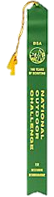

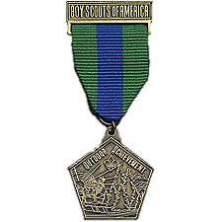


Scouts BSA Awards
Totin’ Chip
Firem’n Chit
National Outdoor Awards
National Medal for Outdoor Achievement
National Outdoor Challenge Award (Unit Award)
Philmont Wilderness Pledge Achievement Award
Summit Bechtel Reserve Sustainability Award

Slide 13

Venturing
Ranger Award Leave No Trace Core Requirement
Recite and explain the principles of Leave No Trace.
Participate in three separate camping/backpacking trips demonstrating that you know and use Leave No Trace principles.
Make a tabletop display or presentation on the Leave No Trace principles and how they affect the environment and attitude of campers for your crew, another crew, a Cub or Scouts BSA group, or another group or teach a Leave No Trace Awareness course.
Notes:
Changes have been proposed for the requirements, however, they have not been approved yet.

Slide 14
Venturing Outdoor Ethics Awards
Outdoor Ethics Awareness
Explain the Outdoor Code.
Watch the NPS Leave No Trace video.
Complete the Leave No Trace online course.
Complete the Tread Lightly! online course.
Participate in an Outdoor Ethics workshop or training.
SAME AS SCOUTS BSA

Slide 15

Venturing Outdoor Ethics Awards
Outdoor Ethics Action Award
Earn the Outdoor Ethics Awareness Award.
Complete Scouting America’s outdoor ethics orientation course.
Explain how you live up to each of the four points of the Outdoor Code during an outing or adventure.
Read Chapter 7 of the Fieldbook on Leave No Trace; read discussion of Leave No Trace in the Ranger Guidebook, review The Land Ethic in A Sand County Almanac.
Lead a group approved by your unit leader in an activity that explores differing ethical viewpoints using materials from Scouting’s outdoor ethics page, Leave No Trace, or Tread Lightly!
Participate in a Leave No Trace Skills Course, Become a Leave No Trace Trainer, Tread Trainer, or successfully complete a term as a crew officer with responsibility for outdoor ethics training.
Research the complete set of Leave No Trace and Tread Lightly! skills related to a planned outdoor adventure, practice skills to minimize impact, then take the adventure.
Follow the Outdoor Code, Leave no Trace, or Tread Lightly! Principles on three outings and develop a poster or presentation explaining how and why you followed the outdoor Code, Leave No Trace, and Tread Lightly!. Share it with a group approved by your unit leader.
Meet with a Land Manager and discuss what you and your crew can do to minimize impact on recreational ecosystems.
Help plan and participate in a campaign to reduce the adverse impacts on the recreational ecosystem
Help plan and lead either traditional or social media event to educate the public on the importance of protecting the recreational ecosystem
Notes:
https://www.scouting.org/outdoor-programs/outdoor-ethics/awards/venturing/
Go back to paraphrasing the requirements and tell participants where they can see the actual requirements

Slide 16



Venturing Awards
National Medal for Outdoor Achievement
National Outdoor Awards
Philmont Wilderness Pledge Achievement Award
Summit Bechtel Reserve Sustainability Award

Slide 17


Sea Scouts Outdoor Ethics Awards
Outdoor Ethics Awareness
Award being developed and reviewed (2025).

Slide 18

Sea Scouts Outdoor Ethics Awards
Outdoor Ethics Action Award
Currently being written

Slide 19
Sea Scouts Awards
Inclusion in existing Outdoor Awards is under development (2025)

Slide 20
Prepared by
Joshua Lamothe
Revised: April 2025
Sources:
Guide to Advancement (2025)
https://www.scouting.org/resources/guide-to-advancement/
2024 Cub Scout Requirements
https://www.scouting.org/programs/cub-scouts/what-cub-scouts-earn
https://www.scouting.org/outdoor-programs/outdoor-ethics/awards/
https://www.scouting.org/skills/merit-badges/
Notes:
Guide to Advancement - http://www.scouting.org/filestore/pdf/33088.pdf
2024 Cub Scout Requirements – update link

